Slide 1
CSCI 4110 Modeling – Part Two Curves and Surfaces
Mark Green
Faculty of Science
UOIT

Slide 2
Introduction
Polygons give us flat objects, but many real world objects aren’t flat, so we need some way of representing curved surfaces
There are many functions that produce curves, so there are many representation that we could use
We want something that is simple, yet at the same time general enough to model a wide range of surfaces
Low degree polynomials fit the bill, but like polygons we will need to use many of them to represent a complete surface

Slide 3
Introduction
We will start by examining curves, which have a single parameter
This simplifies the mathematics, and most of it generalizes to surfaces
Like polygons, we will piece together multiple curve segments, but there is a complication here
We don’t want the joins between curve segments to be visible, it should look like one continuous curve
Thus, there are extra constraints that we need to impose at the joins

Slide 4
Continuity
Continuity deals with how the curve segments are joined together
We say that a curve is C⁰ continuous if all the pieces match up at their boundaries
Consider two curve pieces f1(t) and f2(t), they are C⁰ continuous if:
f1(1) = f2(0)
If a curve is C⁰ there are no gaps in the curve, but it may not be smooth

Slide 5
Continuity
A curve is C¹ continuous if the first derivatives are equal across the joins
In general a curve is C^{n} continuous if all of the first n derivatives are equal across all of the joins
We will usually be interested in C¹ and C² curves
The parameterization can cause problems for continuity, particularly with the derivatives
The derivatives might point in the same direction, but their magnitude might be different due to the parameterizations
These leads to the idea of geometric continuity, which relies more on the geometry of the curve

Slide 6
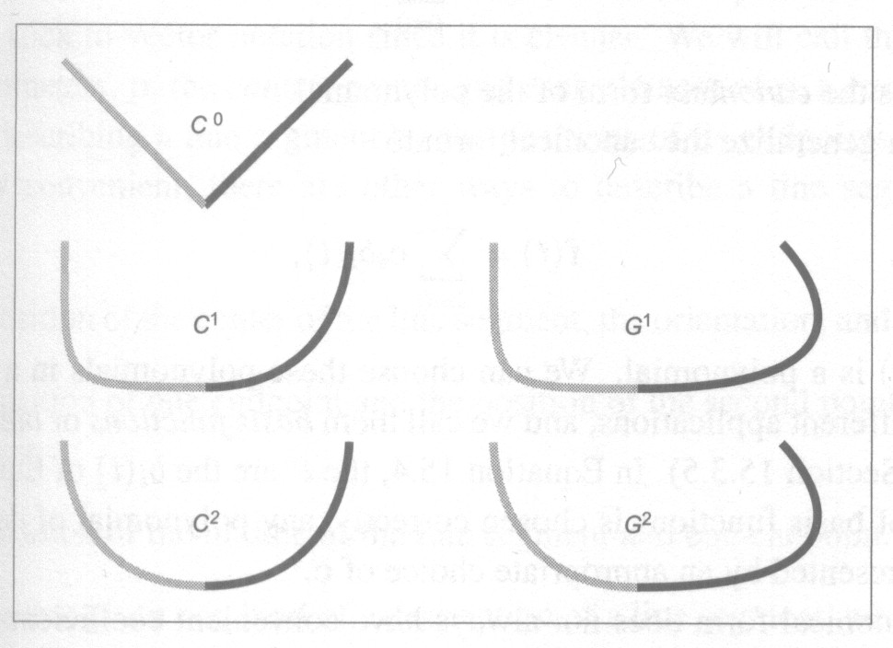
Continuity

Slide 7
Continuity
Two curves are G¹ continuous if they satisfy
f1’(1) = kf2’(0)
Where k is a scalar constant, there are similar definitions for G^{n}
If a curve is C^{n} continuous it will also be G^{n} continuous, but not the other way around

Slide 8
Polynomials
Now that we’ve looked at some of the theory, what form will these representations take?
We use polynomials because they are simple and do a good job
In general a polynomial has the form:

Slide 9
Polynomials
In our case the a_{i} are vectors since f(t) is a vector
While this representation is good for computation, its not particularly good for much else
For example, how are the a_{i} related to the curve geometry?
Given a set of points how do we compute the a_{i}?
We are not particularly good at guessing the value of a_{i} that will produce a given shape
We need some way of obtaining the coefficients from the geometry

Slide 10
Polynomials
This form of the polynomial is called the canonical form
There is a second form that is quite useful:
Here the c_{i} are still vectors, and the b_{i}(t) are polynomials called basis or blending functions
We can choose the b_{i}(t) in any way that’s convenient to us, in particular to make it easy to fit the curve

Slide 11
Polynomials
The simplest form of polynomial is the linear one:
f(u) = a₀ + ua₁
Now let’s look at how we can get the a_{i}
If p₀ and p₁ are the end points, then we can also write the line as:
f(u) = (1-u)p₀ + up₁
f(u) = p₀ + (p₁-p₀)u
Thus 1 and u are our blending functions

Slide 12
Control Points
In this representation we call p₀ and p₁ control points, since they control the shape of the curve
Note that we could choose many different kinds of control points for a line:
The mid point and one end point
One end point and the vector to the other end point
The mid point, slope and distance to one of the end points
For each choice of control points we will have different blending functions, but the same canonical representation

Slide 13
Control Points
Now that we have two representations of the curve we can just equate them to get a_{i}:
a₀ = p₀
a₁ = p₁ – p₀
This is easy in this case, but in general the relationship is not as easy to determine, so we need a general technique
We have that p₀ is the value of f(0) and p₁ is the value of f(1)
This is the basis of our general technique

Slide 14
Control Points
We use the known values to set up a set of equations:
p₀ = f(0) = a₀ + 0a₁
p₁ = f(1) = a₀ + 1a₁
We can put this into matrix form:
C is called the constraint matrix, we need to invert this matrix to give B = C⁻¹, which is called the blending matrix

Slide 15
Control Points
Thus we have the following relationship:
a = Bp
And the canonical representation becomes
f(u) = uBp
u = [1 u u² u³ … u^{n}]
We now have a completely general technique that is independent of the polynomial degree
All we need is B and the control points and we can produce the canonical polynomial

Slide 16
Cubic Curves
While linear polynomials got us started, we really want something that’s curved
Most of the curves we use in graphics are cubic for the following reasons:
High enough degree to produce smooth curves
Low enough degree to be controllable
The mathematics is basically the same for any degree polynomial, but it turns out that the cubic works out best most of the time

Slide 17
Hermite Curves
Note that once we have evaluated uB, we are just multiplying the control points by constants, that is we have a linear combination of the control points, we will see more of this later
To see how this works for cubic curves we will look at the Hermite curve, in this case we specify the position and derivatives at the two end points, that is we have f(0), f’(0), f(1) and f’(1) and we want to find the polynomial coefficients

Slide 18
Hermite Curves
We can construct the equations in the following way:
Which gives us the following:

Slide 19
Continuity
Now let's come back to the problem of putting curve segments together to produce a piecewise curve
Each piece of the curve will have a range of parameter values, we will usually use 0 thru 1 as this range
Similarly there will be a range of parameter values that cover the complete curve, typically this will range from 0 to n, where there are n pieces
We have one global parameter space and n local parameter spaces

Slide 20
Continuity
We can perform a simple translation from the global parameter space to the local parameter space of each piece
In the global parameter space there are parameter values where one curve segment stops and the next curve segments starts
These places are called knots, and for simple curves they have the values: 0, 1, 2, … n
These are parameter values, not positions

Slide 21
Continuity
We know that we have the problem of continuity as we move from one piece to the next
If the pieces are independent how do we maintain this continuity?
There are several approaches to this problem, the easiest is to share control points, called a shared point scheme
That is, the control point at the end of one piece is the control point at the start of the next piece
This assumes that the pieces are defined in terms of values at their end points

Slide 22
Continuity
In general this is too restrictive
Another approach is to copy the values at the end of one piece to the start of the next piece, called a dependency scheme
This doesn’t force us to have a control point at the end of each piece, we can just evaluate the curve at that point and pass this value on to the next piece

Slide 23
Continuity
The third approach is to use an explicit equation to connect the two pieces
This could be a constraint on the control points, or on the curve value at particular points
Note that all three of these schemes introduce constraints or connections between the pieces, so a change in one piece can propagate along the curve

Slide 24
Local Control
This introduces the idea of local control
A curve has local control if a change in a control point only effects a small number of pieces
That is, changing a control point only effects the local shape of the curve, it has no impact on the parts of the curve that are far away
Locality is important in design, we don’t want a small change to have a big impact on the curve
We want to be able to work on one part of the curve at a time

Slide 25
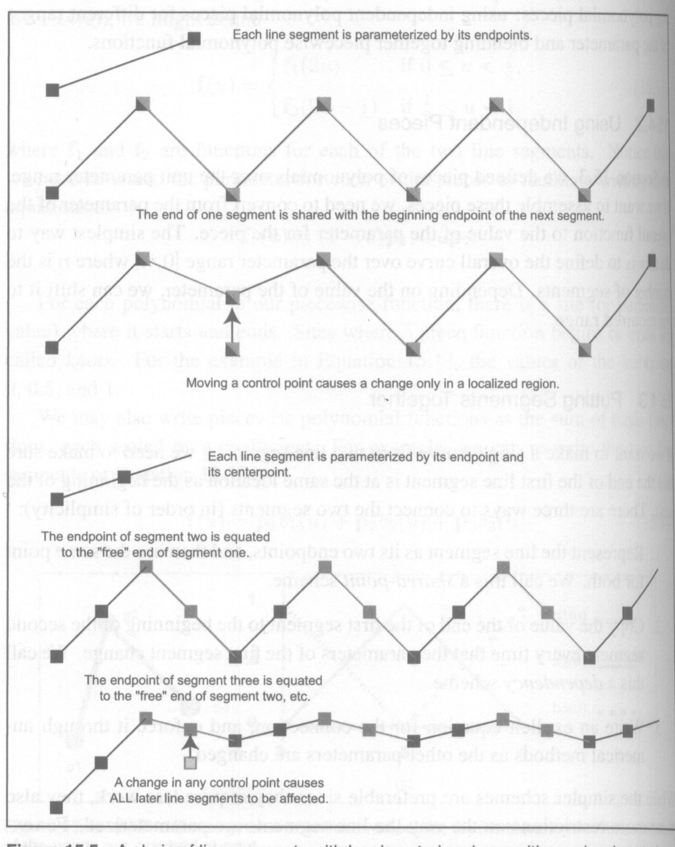
Local Control

Slide 26
Natural Spline
To see how this works we will develop the natural cubic or natural spline
With a cubic we can produce a C² curve
To do this we specify the position and the first two derivatives at the start of the piece, which are the values from the end point of the previous piece
The only independent value we have is the position at the end of the curve
Note that this is a dependency scheme, with the values at the start of the piece dependent on the values at the end of the previous piece

Slide 27
Natural Spline
We can set up the equations and their solution in the following way:

Slide 28
Natural Spline
This curve gives us the maximum degree of continuity for a cubic curve, but there is a price to be paid
This curve doesn’t have local control
If we make a change to any of the control points the change has an impact on all of the pieces after the control point
Making a change at the start of the curve effects the shape of the entire curve

Slide 29
Hermite Curve
The Hermite curve can be used to produce C¹ continuity in the following way
For a Hermite piece we specify both the positions and first derivatives at each end of the curve
By equating the position and derivative at the start of a piece with the position and derivative at the end of the previous piece we produce a C¹ curve

Slide 30
Hermite Curve
We can manipulate the derivatives, but we must make sure that the derivative at the end of one piece is connected to the derivative at the start of the next
That is, we cannot manipulate the two derivatives independently
One of the benefits of this approach is that it gives us local control over the curve shape, changing a derivative only effects two pieces

Slide 31
Cardinal Spline
The Cardinal spline is also a C¹ curve, but it uses its control points in a different way
If we have n control points there are n-2 pieces, with piece i using control points i, i+1, i+2, and i+3
For piece i the curve is drawn between control points i+1 and i+2, which is different from what we have seen before
The derivative at the start of the curve is given by the vector between the first and third control points, and the derivative at the end is given by the vector from the second to the fourth control point
This ensures that the derivatives between pieces are linked

Slide 32
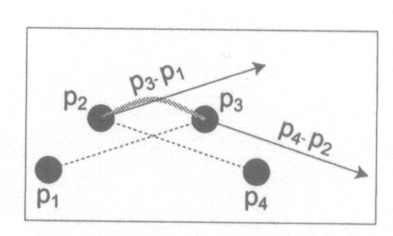
Cardinal Spline

Slide 33
Cardinal Spline
Cardinal splines have a parameter called the tension, t, that controls how tight the curve is between control points
Tension is a number between 0 and 1 and scales the derivatives:
f(0) = p₂
f(1) = p₃
f’(0) = ½(1-t)(p₃-p₁)
f’(1) = ½(1-t)(p₄-p₂)
We usually set s = (1-t)/2 to simplify the equations

Slide 34
Cardinal Spline
For the Cardinal splines we have (note change of indices for p₁ to p₄):

Slide 35
Cardinal Spline
Note that the curve starts at the second control point and ends at the n-1 control point
We can solve this problem by adding two extra points at the two ends of the curves
The Cardinal spline does a good job of interpolating points with C¹ continuity
The tension parameter gives us a way of controlling the curve’s shape

Slide 36
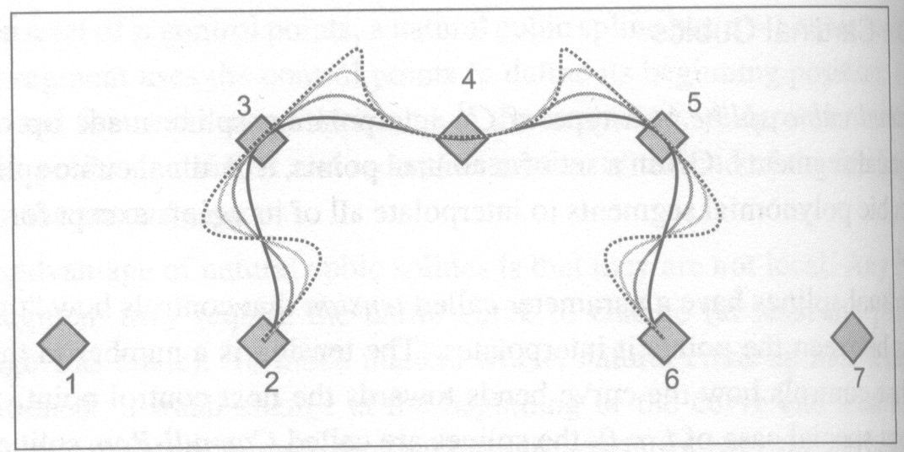
Cardinal Spline

Slide 37
Bezier Curve
The Bezier curve is one of the most common curves used in computer graphics
The main feature of this curve is the amount of control it gives the user over its shape
It has very good local control properties, with changes effecting at most two pieces
In addition, manipulating the control points has an intuitive impact on the curve’s shape
It is very easy to design with Bezier curves

Slide 38
Bezier Curve
The main disadvantage is they only guarantee C⁰ continuity and if some constraints are placed on the control points C¹ continuity can be achieved
The Bezier curve interpolates its first and fourth control points
The derivative at u=0 is three times the vector from the first to the second control point
The derivative at u=1 is three times the vector from the third to the fourth control point
Thus, the shape of the curve is controlled by moving the second and third control points, while the position is controlled by the first and fourth

Slide 39
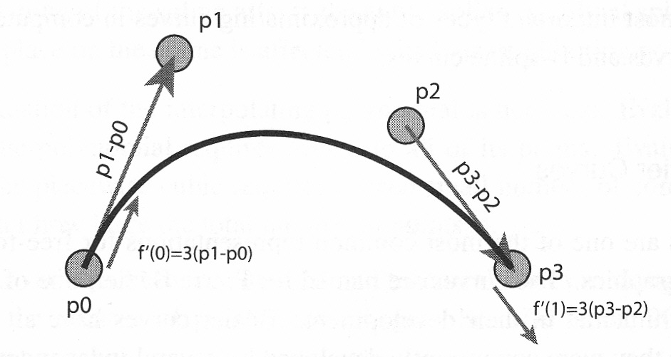
Bezier Curve

Slide 40
Bezier Curve
Putting all of this information together we get the following:

Slide 41
Bezier Curve
If we multiply out uBp we get the following result:
The blending functions are called the Bernstein basis

Slide 42
Bezier Curve
We can generalize this to any degree n, where the Bernstein basis are given by:
While building an n’th degree Bezier curve is quite easy, we will stick to cubic ones
Bezier curves have a number of interesting properties: they are bound by the convex hull of their control points

Slide 43
Bezier Curve
The convex hull is the smallest polygon that contains the control points
This means that we can bound the area where the curve can appear
Another interesting property is that any line intersects the curve no more times than it intersects the lines connecting the control points
This is called the variation diminishing property
The curve wiggles no more than the lines connecting the control points

Slide 44
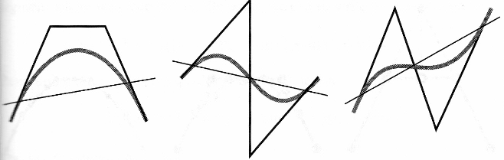
Bezier Curve
Variation Diminishing Property

Slide 45
Bezier Curve
Bezier curves are affine invariant: we can translate, rotate, scale and skew the control points and the curve will be transformed in the same way
Instead of trying to transform the curve, we just need to transform its control points
In addition the curves are symmetric, we can reverse the order of the control points and the curve has the same shape
Since Bezier curves have been used for many years a number of very efficient algorithms have been developed for them

Slide 46
Bezier Curve
When it comes to piecing together Bezier curves we need to be careful
Usually a shared control point scheme is used where the last control point of one piece is the first control point of the next
This only guarantees C⁰ continuity since the curve derivatives are controlled by other control points

Slide 47
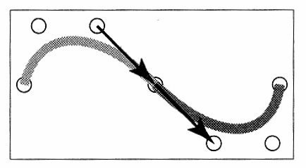
Bezier Curve
If we want the curve to be G¹ continuous the three control points at the join must be collinear, for C¹ the two line segments must be of equal length

Slide 48
B-Spline
We now come to the most complicated curve that we will study, the B-spline
The B-spline is a very general curve that gives us considerable control over the curve’s shape
It is the only curve that can change its continuity along the length of the curve
It also has many of the advantages of the Bezier curve
There are multiple forms of B-splines and they are used extensively in other disciplines

Slide 49
B-Spline
The term B-spline is often used for both the basis function (the correct usage) and the overall curve, this just adds to the confusion over these curves
In general the curve has the following form:

Slide 50
B-Spline
The b_{i}(t) are the B-spline or blending functions and are polynomials of degree d
Unlike previous curves there is no relationship between d and the number of control points n
For all the previous curves if we increased the number of control points, we also increased the degree
Alternatively, we can view the B-splines as providing their own piecewise representation scheme

Slide 51
B-Spline
B-splines have a parameter k, which is one greater than the degree of the blending functions
The important properties of B-splines are:
C^{(k-2)} continuous
Made of polynomials of degree k-1
Local control, any point on the curve depends on k control points
Bounded by convex hull of control points
Variation diminishing property

Slide 52
B-Spline
We will start by looking at linear B-splines, that is k=2 and work our way up to the general case
In this case the basis functions b_{i,2}(t) are given by:

Slide 53
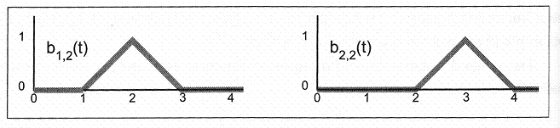
B-Spline
Two of the blending functions are shown below
Note that each function only covers 3 knots: i, i+1, and i+2

Slide 54
B-Spline
Some of the properties of the blending functions are:
Each one has k+1 knots
Each one is zero before its first knot and after its last knot
Local control, since each control point is multiplied by one blending function which is non-zero over a small range
The complete curve has n+k knots
The set of blending functions sum to 1 for all parameter values between knots k and n+1

Slide 55
B-Spline
Next we will look at the quadratic or k=3 case
In this case the blending functions are given by:

Slide 56
B-Spline
At any parameter value only three of these blending functions will be non-zero, so at most 3 control points will influence the curve’s shape at any parameter value
The next slide shows a single blending function and how seven of these functions align along a portion of the parameter range
You can see from these figures how the blending functions sum to 1 at each parameter value

Slide 57
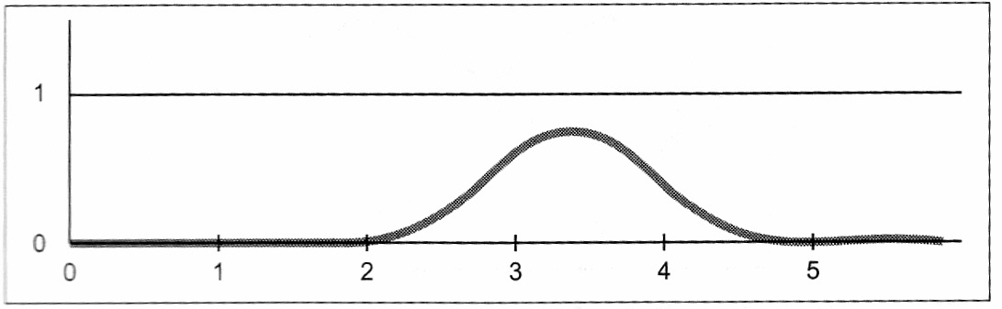
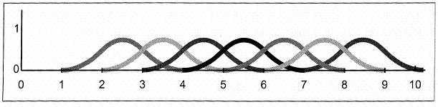
B-Spline

Slide 58
B-Spline
Finally we get to the cubic case, in this case the blending functions are given by:

Slide 59
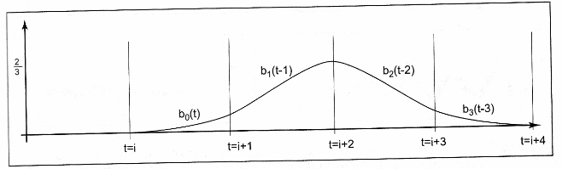
B-Spline
A typical cubic blending function is shown below
This function is non-zero for only 5 knots, so again it has local control

Slide 60
B-Spline
For the B-splines that we have looked at so far we can still use the matrix representation of the blending functions, it just a matter of expanding and collecting terms
B-splines are more general than what we have seen so far
The B-splines that we have seen so far are called uniform B-splines since their knot values are uniformly spaced

Slide 61
B-Spline
If we have n control points and a k order B-spline then we have n+k knots
So far the values we have used are [1, 2, 3, 4, … n+k], that is the knot values have been uniformly spaced
This doesn’t need to be the case, the knots only need to be a non decreasing sequence, ie t_{i+1} ≥ t_{i} , in fact several knot values could be equal

Slide 62
B-Spline
Why is this interesting/important?
The control points are tied to the knots by the blending functions, so by controlling the knot values we can control the influence that a control point has on the curve
Each control point is only influenced by a small number of knots, so we can control the range of this influence

Slide 63
B-Spline
So given a vector v of knot values, how do we compute the blending functions?
This is done recursively in the following way:

Slide 64
B-Spline
These equations are called the Cox-de Boor recurrence
If we substitute a uniform knot vector into these equations we will get the same blending functions that we saw before
These equations allow us to generate the blending functions for other values of k, and for non-uniform knot sequences

Slide 65
B-Spline
How can we use the knot vector to control the curve shape?
We can start by investigating duplicated knots
Each control point is associated with k knots, since we have local shape control
If all of these knots are equal then the curve must interpolate that point if the knot is repeated k times, since for that parameter value there is only one control point

Slide 66
B-Spline
Each time the knot is repeated the curve is tugged or pulled at that knot value
Thus each repetition decreases the continuity by one
If we repeat the knot k-1 times we end up with C¹ continuity
Similarly if we repeat the knot more than k times there will be gaps in the curve
We can force the curve to interpolate its two end points by repeating the knot values at those points
Thus by manipulating the knot values we can control the level of continuity along the curve

Slide 67
NURBS
The final type of curve that we will look at is NURBS, or non-uniform rational B-spline curve
This curve is used extensively in computer animation and computer aided design, so you should at least know of its existence
Despite being quite general B-splines can’t represent conic sections, which are quite important in design
In order to represent conic sections we need to have the ratio of two polynomials
There are other shapes that NURBS can represent, but B-splines can’t, so they have proved to be quite useful

Slide 68
NURBS
A NURBS curve associates a scalar weight h_{i} with each control point, which gives us a bit more freedom in controlling the curve’s shape
A NURBS curve is given by:
A number of algorithms have been developed to display and manipulate NURBS, but they are beyond the scope of this course

Slide 69
NURBS
A good resource for NURBS is:
Les Piegl, Wayne Tiller, The NURBS Book, 2nd Edition, Springer. 1997

Slide 70
Basis Conversion
The canonical representation of curves gives us a useful techniques for converting between different types of control points
Given a set of control points, we multiply by B the blending matrix to get the canonical polynomial
For each type of curve there is also the constraint matrix C which goes in the opposite direction, that is from polynomial coefficients to control points

Slide 71
Basis Conversion
Given a set of control points p₁ in one representation, we can convert them to another representation p₂ in the following way
We convert p₁ to canonical polynomial coefficients a in the following way:
a = B₁p₁
Where B₁ is the blending matrix for the first representation, the vector a is independent of the representation

Slide 72
Basis Conversion
We then convert to the second representation in the following way:
p₂ = C₂a
Where C₂ is the constraint matrix for the second representation
This is useful for displaying curves in OpenGL, where the functions are based on Bezier control points

Slide 73
Curved Surfaces
We have looked a lot at curves, but what if we also want to do surfaces?
It turns out that this is a fairly easy generalization in the case of uniform knots
For curves we have 4 control points for cubic curves
In 3D we use bicubic polynomials, these are cubic polynomials in both of the parameters, so there will be 16 polynomial coefficients
Therefore we will need 16 control points, which we can store in a 4x4 matrix

Slide 74
Curved Surfaces
We have two parameter vectors
That is the surface is given by f(u,v), so we construct two parameter vectors:
U = [1 u u² u³]
V = [1 v v² v³]
Given the control points, we need to produce 16 polynomial coefficients
Luckily we can use the same blending matrix for this purpose, which gives us the following:
A = BPB^{T}
With this in mind its easy to construct the surface:
f(u,v) = UBPB^{T}V^{T}

Slide 75
Curved Surfaces
The surfaces have basically the same properties as the corresponding curves
For the Bezier surface the matrix of control points is set up in the following way:
The four corners of the matrix are points on the surface
The remaining points along the edges define the Bezier curves that are the edge of the surface patch
The 4 remaining points control the curvature in the middle of the surface patch
This is shown on the next slide

Slide 76
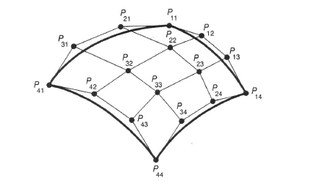
Curved Surfaces

Slide 77
Curved Surfaces
When connecting patches together we also need to consider continuity
For the Bezier patch the control points along each join must be the same the ensure C⁰ continuity, see the next slide
If we want G¹ continuity across a join the control points across the join must be collinear, and the line segments must be of the same length for C¹ continuity

Slide 78
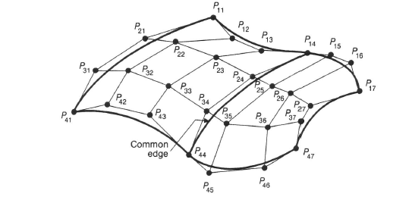
Curved Surfaces

Slide 79
Display
At first it seems that displaying curves and surfaces is relatively easy, we just evaluate the curve at uniformly spaced parameter values along the curve and then connect the points with lines
There are two problems with this approach:
The number of line segments required depends upon the curvature, which may not be uniform along the curve
Uniformly spaced parameter values don’t produce uniformly spaced points along the curve
If the curve is flat it can be approximated with a straight line, so we want to find the flat segments

Slide 80
Display
We will illustrate the basic approach with Bezier curves
We can construct a recursive algorithm to draw the curve, the basic outline of the algorithm is:
If the curve is flat enough draw a line between the first and last control point
Otherwise, divide the curve in half, in parameter space and apply the algorithm recursively to the two halves
The curve subdivision is quite easy to do with Bezier curves

Slide 81
Display
The subdivision techniques is based on a construction due to de Casteljau, see the next slide
The original control points for the curve are P₁, P₂, P₃, and P₄ and the constructed control points for the two new curve segment are:
Left curve: L₁, L₂, L₃ and L₄
Right curve: R₁, R₂, R₃ and R₄
Start by constructing H, which is the midpoint of P₂P₃
Next L₂ is the midpoint of P₁P₂ and L₃ is the midpoint of L₂H, we can do the same thing to construct the control points of the right curve

Slide 82
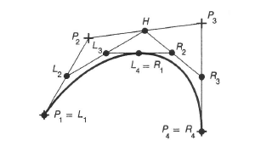
Display

Slide 83
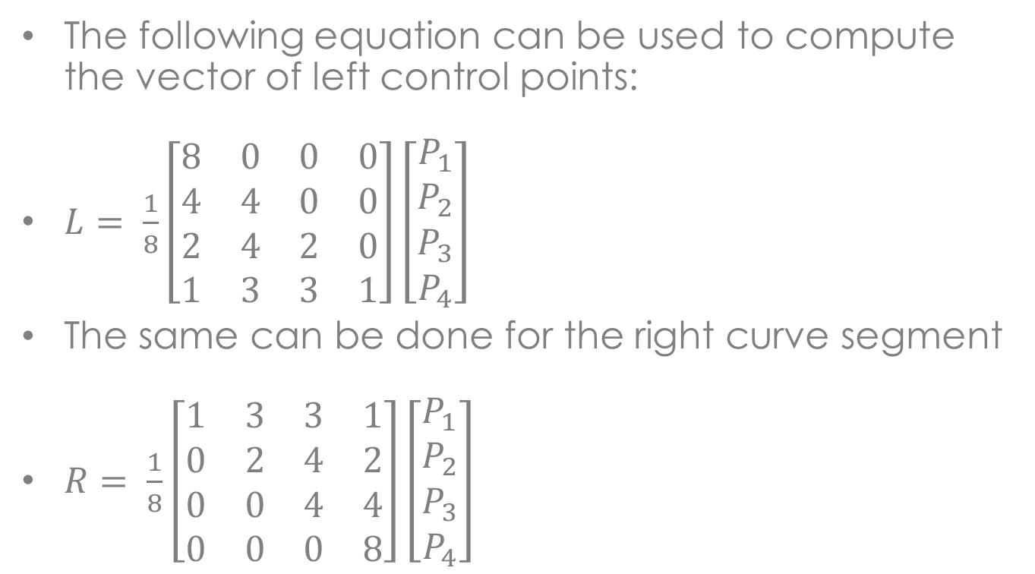
Display
The following equation can be used to compute the vector of left control points:
$L= \frac{1}{8}\left[\begin{matrix}8 & 0 & 0 & 0 \\ 4 & 4 & 0 & 0 \\ 2 & 4 & 2 & 0 \\ 1 & 3 & 3 & 1\end{matrix}\right]\left[\begin{matrix}P_{1} \\ P_{2} \\ P_{3} \\ P_{4}\end{matrix}\right]$
The same can be done for the right curve segment
$R= \frac{1}{8}\left[\begin{matrix}1 & 3 & 3 & 1 \\ 0 & 2 & 4 & 2 \\ 0 & 0 & 4 & 4 \\ 0 & 0 & 0 & 8\end{matrix}\right]\left[\begin{matrix}P_{1} \\ P_{2} \\ P_{3} \\ P_{4}\end{matrix}\right]$

Slide 84
Display
In the case of Bezier curves testing if the curve is flat is relatively easy
P₁P₂ and P₄P₃ are tangent to the curve at the end points, if P₂ and P₃ are sufficiently close to the line between P₁ and P₄ the curve is considered flat, see the next slide
Surfaces can be displayed in basically the same way, except we are dealing with quadrilaterals and not lines
Could actually do the subdivision down to the pixel level – Catmull’s algorithm

Slide 85
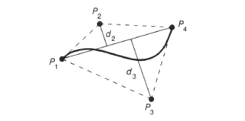
Display

Slide 86
Summary
Examined the basic modeling techniques used on computer graphics, polygons and curved surfaces
Data structures for storing polygonal meshes
Basic properties of curves and surfaces
Differential geometry for computer graphics

